Slide 1
ENTERING ASSET DISPOSALS
IN THE FAM
NB: This process is only done by trained FA specialist in the Regional office or AMG/HQ
GSM function required: FA Specialist - Global

Slide 2
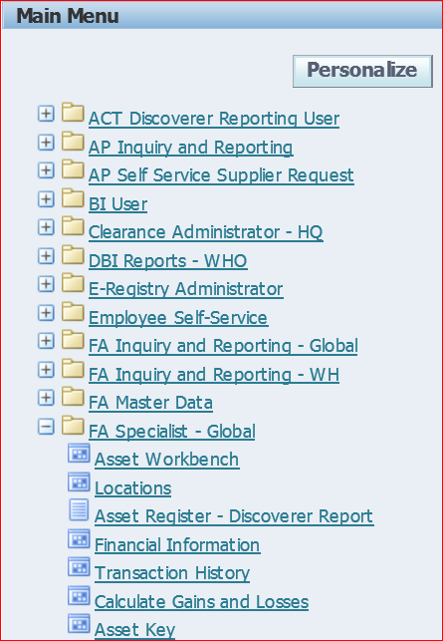
ASSET DISPOSAL
Click FA Specialist - Global
Select Asset Workbench

Slide 3
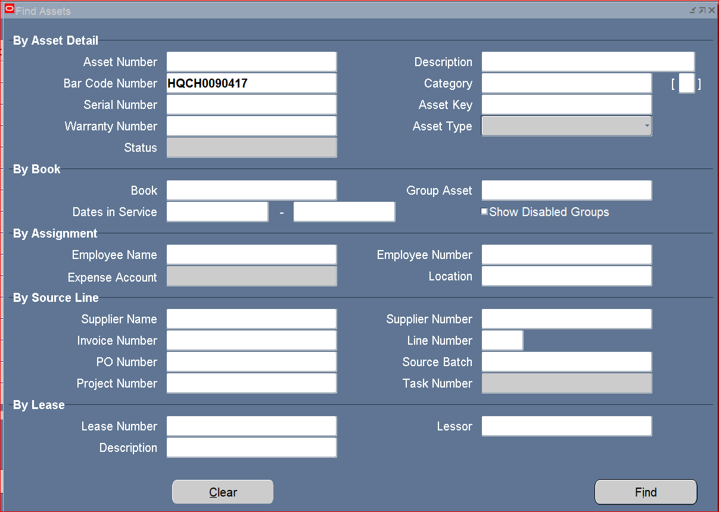
Enter the Barcode number
Click Find

Slide 4
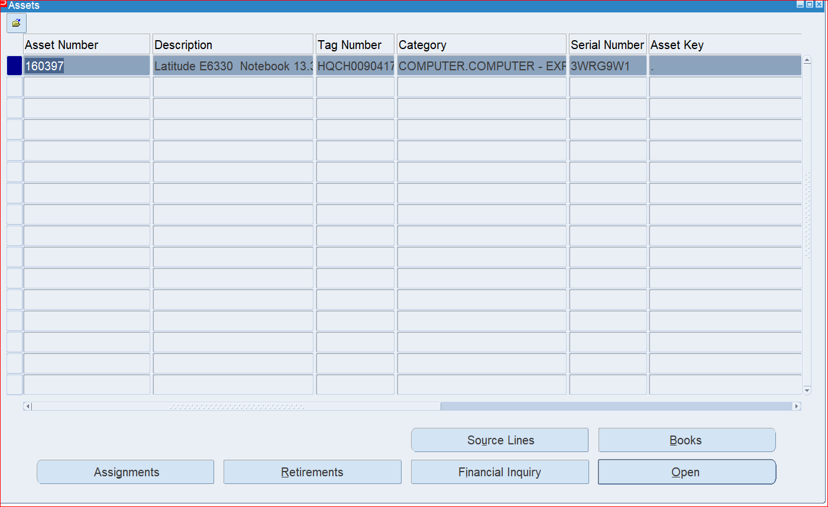
Click Open

Slide 5
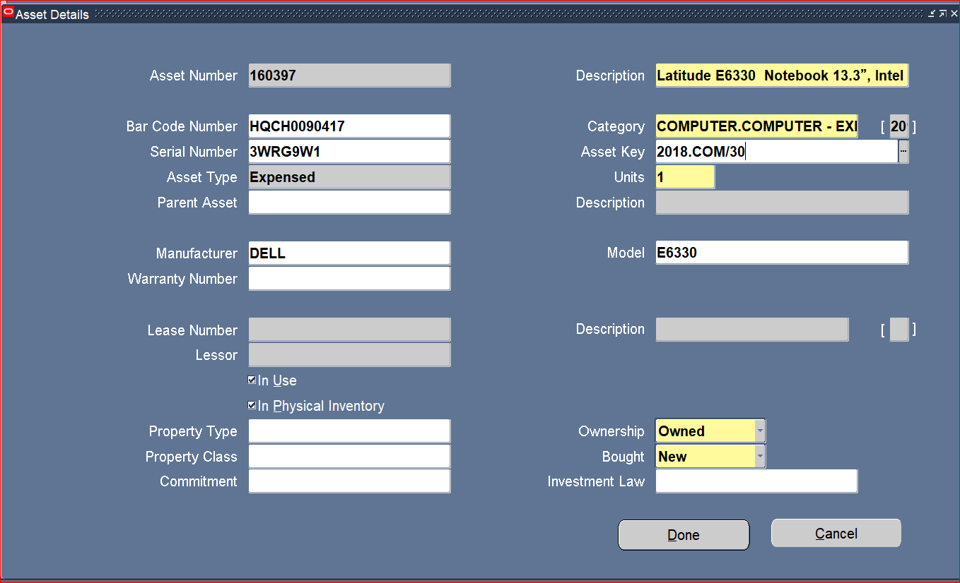
Enter the Asset Key
which is the
PSC/PSS Approval Reference
Note: This is optional but useful for future search criteria
Click Done

Slide 6
Search the asset to perform the disposal
Type the Barcode number
Click Find

Slide 7
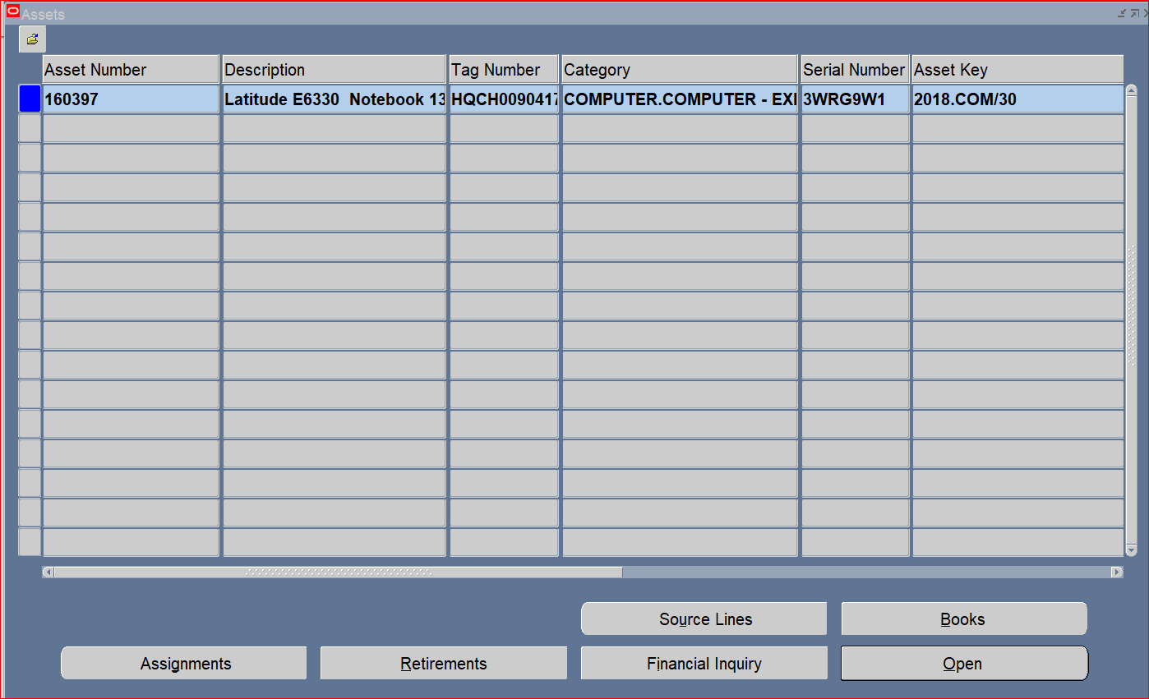
Note the asset key you entered appears here. This column is shown in the asset register
Click Retirement

Slide 8
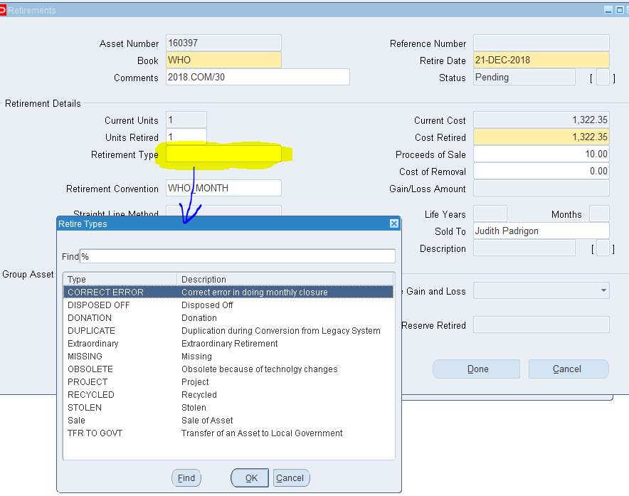
Select Book “WHO”
Enter Retirement Date
Type the “Approval Ref no.” in the Comments
Click Cost Retire field.
Note: always the same as the cost
Enter 1 for the units retired
Type the Proceeds of Sale & ALWAYS THE USD VALUE OF THE PROCEEDS RECEIVED.
Select Retirement Type from the drop down list and then click
OK
Optional: Type the Sold To
Click Done

Slide 9
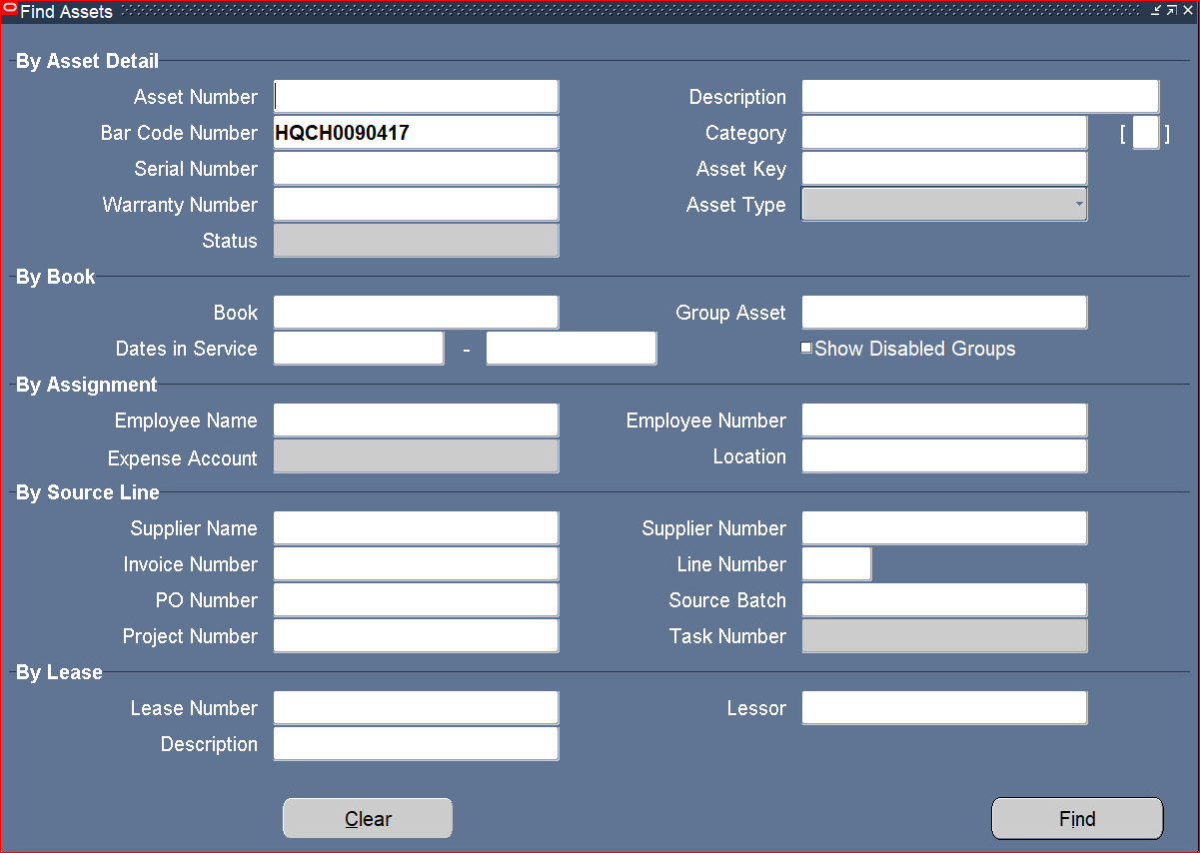
To check the disposal
Search the asset in the Workbench using the Barcode No.
Click Find

Slide 10
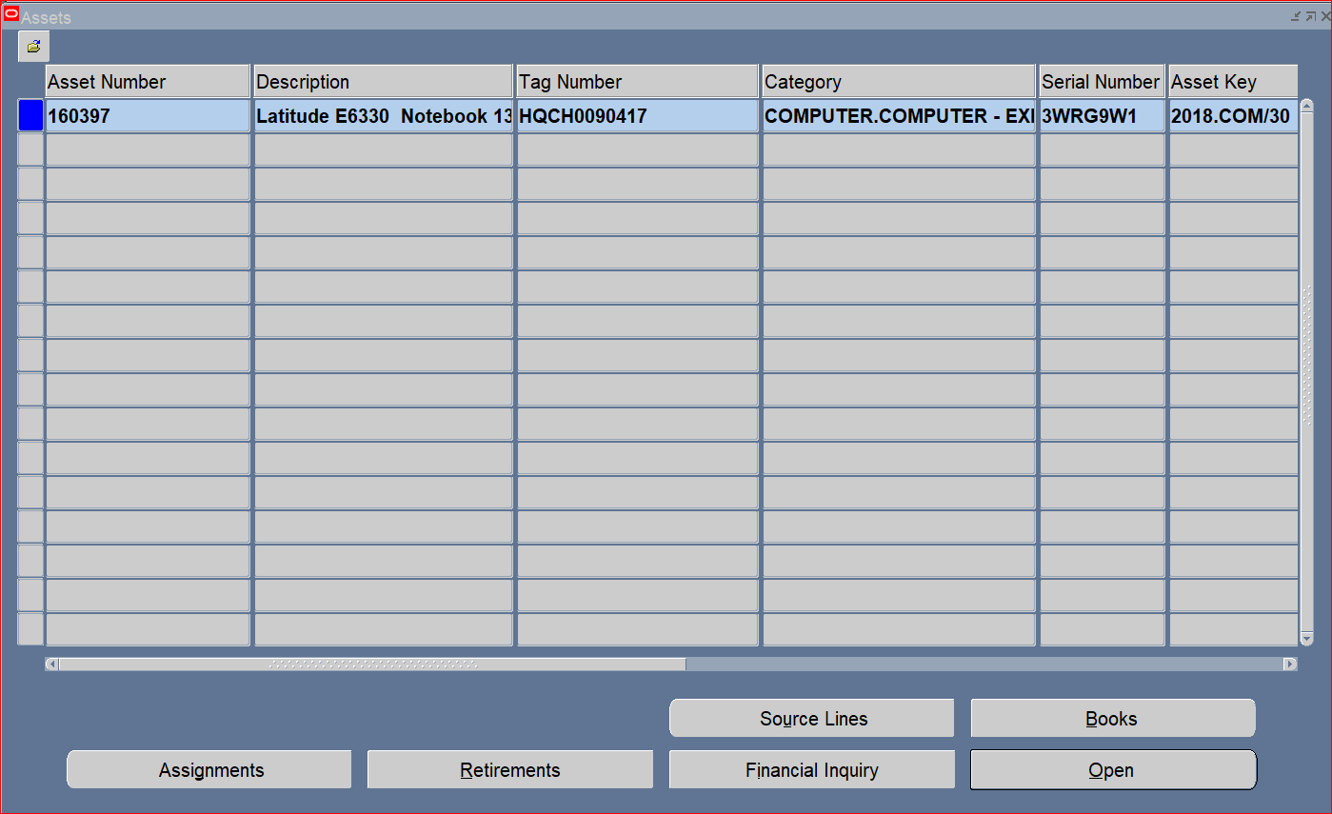
Select and click Financial Inquiry

Slide 11
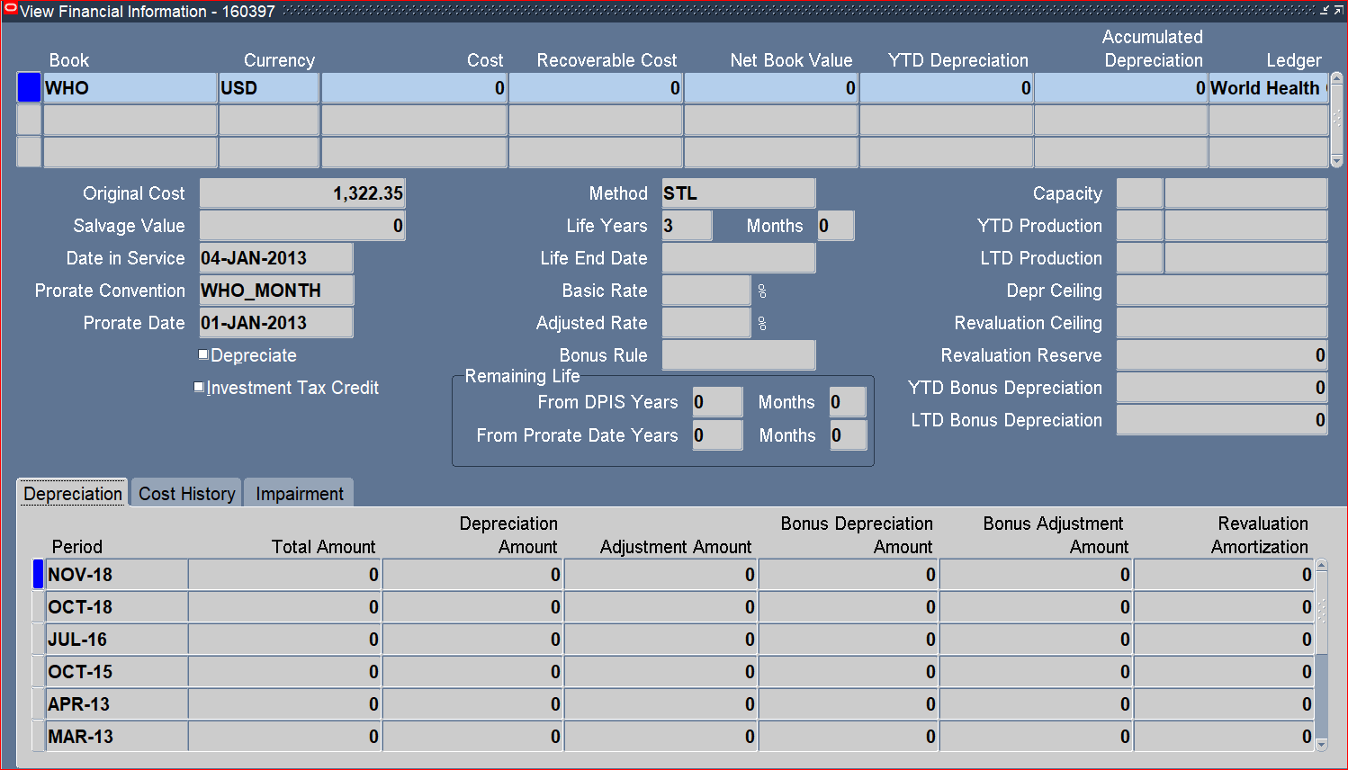
Select Cost History

Slide 12
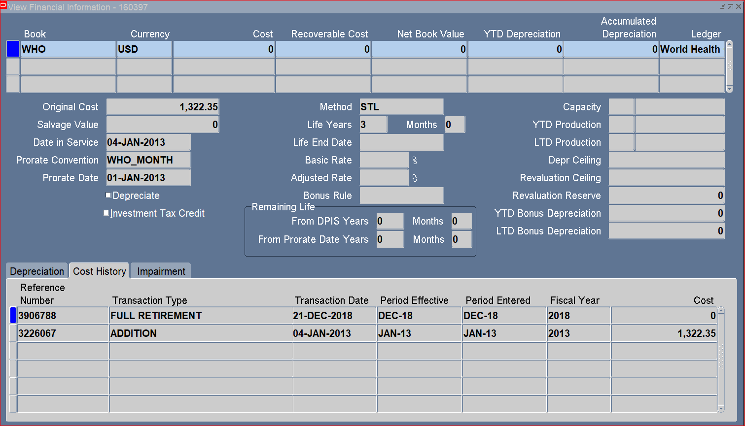
Click ”X” to close
The Transaction Reference Number and Transaction type are displayed

